Slide 1
Phase 3 project - Pump it Up Project

Slide 2
Agenda
Title Slide
I ntroduction - Why This Matters
The Problem - Broken Pumps
Our Data - Understanding the Pumps
s What IDid - The Prediction Process
Our Goal - 85%+ Accuracy
Model Performance Overview
Next Steps
1o Questions
Contact I nformation

Slide 3
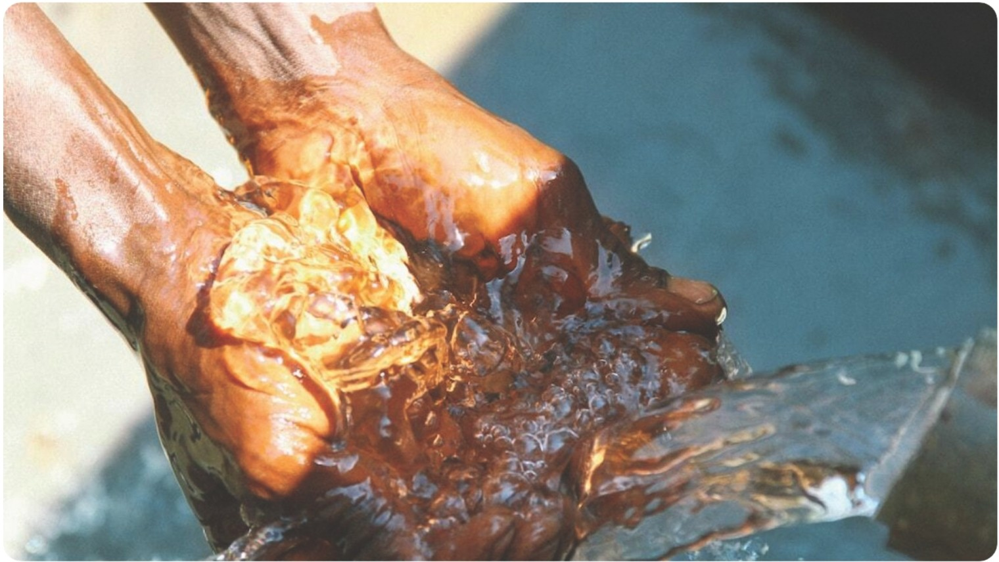
IPump it Up Project
A Data-Driven Solution for Reliable Water Pumps maintenance
Photo by Justin Meeker on Unsplash

Slide 4
Introducti on - Why This Matters
Critical Need for Clean Water Access to clean drinking water is fundamental to public health, yet many Tanzanian communities still struggle with waterborne diseases due to contaminated sources.
Dependency on Water Pumps
In rural areas, water pumps are the primary source of freshwater, making their functionality essential for daily life, sanitation, and economic activities.
Project Aim: Proactive Maintenance
Our primary goal is to develop
predictive models that foresee necessary repairs, minimizing downtime and ensuring consistent water supply.

Slide 5
The Problem - Broken Pumps
Prevalence of Non-Functional Pumps
An estimated 1 in 5 water pumps in Tanzania are reported to be non-functional at any given time, severely impacting local water access.
Identifying Repair Needs is Challenging Communities often lack timely information on pump status, leading to delays in repairs and unreliable water access, compounded by limited resources.

Slide 6
Our Data - Understa nding the Pumps
••
Data
Utilizing community-reporting platform Taarifa and data from the Ministry of Water, we get comprehensive insights on pump performance.
Extensive Pump Analysis Our analysis encompasses over 59,400 pumps, offering a rich dataset for predictive modeling and maintenance forecasting.
Predictive Insights Through this data, we aim to develop models that can accurately predict the functionality of pumps, enabling proactive maintenance.

Slide 7
What I Did - The Prediction Process
Rigorous Data Cleaning : Cleaning and preparing data is crucial; it ensures the reliability of our predictive models, contributing to valid outcomes.
Key Insights on Pump Dynamics: Understanding variables such as pump age, usage patterns, and pump location allows us to establish correlations crucial for predictions.
Developing a Prediction Tool: By using advanced machine learning techniques, we fashioned a tool capable of predicting pump status based on input from various factors.

Slide 8

Our Goal - 85%+ Accura cy
·Setting High Standards for Prediction Accuracy: Aiming for over 85% accuracy in predictions will significantly improve our ability to manage pump maintenance effectively.
·Current Performance : Currently, our model achieves an accuracy of 81%, which serves as a strong foundation on which to build and refine our techniques.
·Strategies for Improvement: Continuous evaluation, incorporation of new data sources and trying other machine learning techniques might help us enhance predictive capabilities and overall performance.
Photo by Ricardo Arce on Unsplash

Slide 9
Model Performance Overview
Performance by Category:
• Functional:
– Strong performance (81% precision, 89% recall)
• Non Functional:
– Also shows solid results
• Functional Needs Repair:
– Lower performance (58% precision, 35% recall)
– Indicates this category is more challenging
Key Takeaway:
• The model performs well overall, but the "functional needs repair" category needs improvement.
Overall Accuracy:
• Model is correct 81% of the time.

Slide 10
Next Steps – R efining and Acti ng
Continued Accuracy Enhancements
Ongoing assessments and integration of more data will boost the predictive capabilities of our model further.
Strengthening Collaborations Effecting real change requires cooperation; partnerships with local organizations will be vital in executing repairs effectively.
Automated Machine Learning pipeline
For more robust model, we need a continues more data and preferable from diverse data source and with automated pipeline we will reduce man power significantly

Slide 11


Slide 12
CONTACT INFO
Name: Adnan Mohamud
Email Address: adnanahmedmohamud1@gmail.com

